Slide 1
Automatic detection of invasive ductal carcinoma in whole slide images with Convolutional Neural Networks
Weituo Hao
Xiang Yu
Computer and Information Science Stony Brook University
whao@cs.stonybrook.edu

Slide 2
Topics
Problem Definition
Method
Experimental evaluation
Future work

Slide 3
Problem Definition
Given a set of digitized whole slide pathology images
labeled by 0 and 1. Use CNN architecture to classify them.
Note that the digitized whole slide pathology images are often several gigabytes in size.

Slide 4
Method
Step 0 Attempted Pre-processing
Step 1 Image sampling
two kinds of images: 20X, 5X
crop size: 400*400
Step 2 Convolutional Neural Networks
two CNNs architecture are adopted
Step 3 IDC probability map
almost there…

Slide 5

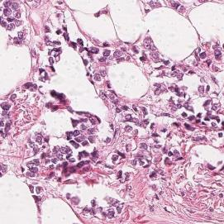
Step 0 Attempted Pre-processing
TCGA-A2-A0SY-01Z-00-DX1.42.3.jpg (left)
image average: [131.631, 135.011, 135.21].
image variance: [1979.31, 1997.48, 2015.77].
TCGA-A2-A0SY-01Z-00-DX1.291.3.jpg (right)
image average: [201.905, 181.914, 212.681].
image variance: [2024.16, 3272.25, 1745.44].

Slide 6
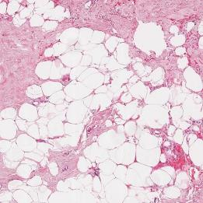
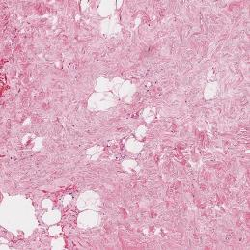
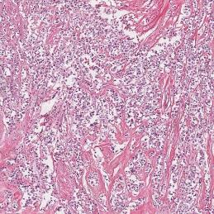
Step 0 Attempted Pre-processing (Cont’d)
But noise (non-cancer patches) only occupies a small part of the cancer image.
So removing noise doesn’t improve accuracy.
And it’s hard to set threshold of removing noise, as variance varies a lot among all the data.

Slide 7
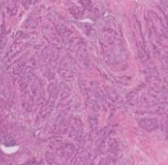
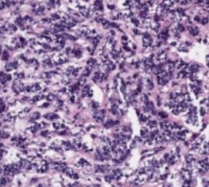
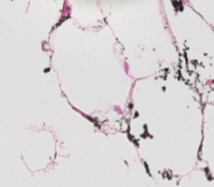
Step 1 image sampling
Each whole slide image will be divided into non-overlapping image patches of x*y pixels (now x=y=400). Patches with mostly fatty tissue or slide background are discarded.

Slide 8
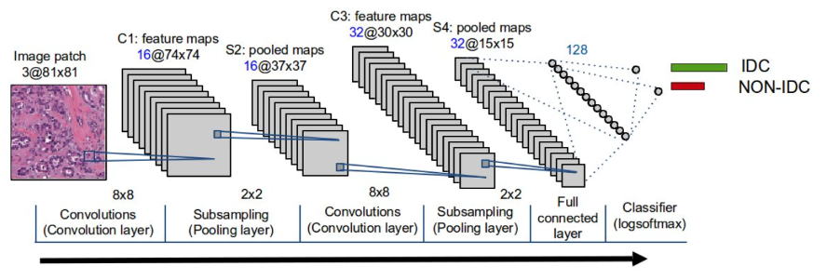
Step 2 Convolutional Neural Networks
Two CNNs architecture with different layers are used
Note we count layers based on convolution operation ignoring relu or pooling.
4-layer CNN:
10*10(2)+5*5+3*3+3*3
7-layer CNN:
5*5(2)+4*4+3*3+3*3+3*3+3*3+3*3

Slide 9
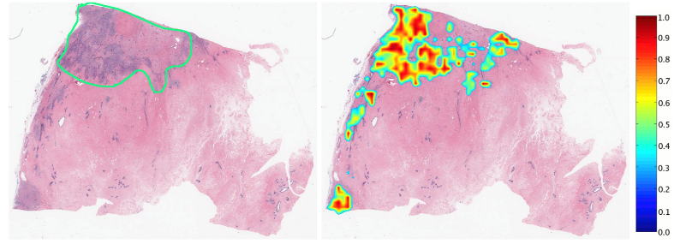
Step 3 IDC probability map
By exponential function, the output of log softmax classifier can be converted to values range from 0~1
Combining with patch’s location, we get the IDC probability map
What we have now:
The score ranges from (0,1) for each patch.

Slide 10
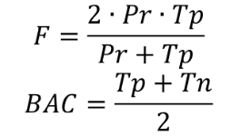
Experimental Evaluation
Data sources:
https://public.cancerimagingarchive.net/
http://cancer.digitalslidearchive.net/
Algorithm evaluation
where Pr means the precision, Tp means the true positive, Tn means the true negative.

Slide 11
Experimental Evaluation
Data: 700,000 image patches of 20X and 5X each.
training set: 70,000 patches
testing set: 10,000 patches
Process: 4_layer CNNs on 20 X.
4_layer CNNs on 5X.
7_layer CNNs on 5X (still running).

Slide 12
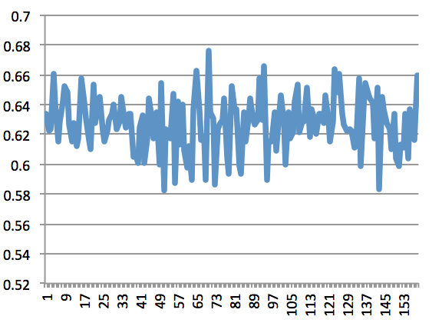
Uniformly sample accuracies as iterations increase
4_layer CNNs on 20X, avg: 0.6375, iter: 99000

Slide 13
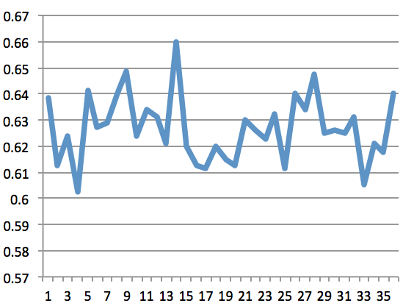
Uniformly sample accuracies as iterations increase
4_layer CNNs on 5X, avg:0.6263 , iter: 36000

Slide 14
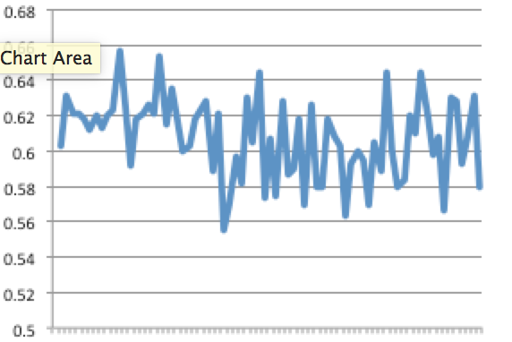
7_layer CNNs, avg 0.6025, iter 70,000

Slide 15
Reference
[1] Angel, C., Ajay, B., et al, “Automatic detection of invasive ductal carcinoma in whole slide images with Convolutional Neural Networks,” Medical Imaging 2014: Digital Pathology, Vol.9041

Slide 16
Thank You

